Slide 1

Capstone Engagement
Assessment, Analysis, and Hardening of a Vulnerable System

Slide 2
Table of Contents
This document contains the following sections:
01
Network Topology
02
Red Team: Security Assessment
03
Blue Team: Log Analysis and Attack Characterization
Hardening: Proposed Alarms and Mitigation Strategies
04

Slide 3
Network Topology
‹#›

Slide 4
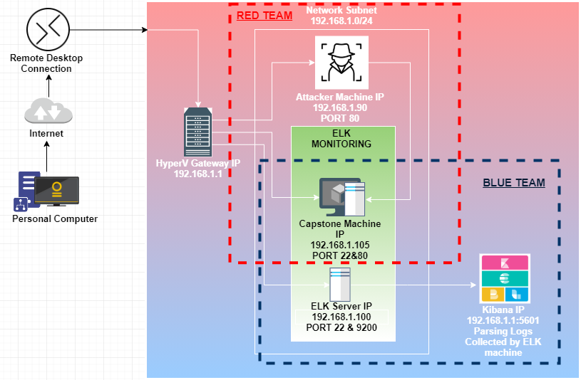
Network Topology
Network
Address Range: 192.168.1.0/24
Netmask:255.255.255.0
Gateway:192.168.1.1
Machines
IPv4:192.168.1.1
OS:
Hostname:
IPv4:192.168.1.90
OS: Linux
Hostname: Kali
IPv4:192.168.1.100
OS: Linux
Hostname: ELK-Stack
IPv4:192.168.1.105
OS: Linux
Hostname: Capstone

Slide 5

Red Team
Security Assessment
‹#›

Slide 6
Recon: Describing the Target
Nmap identified the following hosts on the network:
Hostname | IP Address | Role on Network
ML-RefVm-684427 | 192.168.1.1 | NAT Switch
Kali | 192.168.1.90 | Penetration Testing System
Capstone | 192.168.1.105 | Web Server
ELK Stack | 192.168.1.100 | SIEM System

Slide 7
Vulnerability Assessment
The assessment uncovered the following critical vulnerabilities in the target:
Vulnerability | Description | Impact
Directory Listing Vulnerability CWE-548: Exposure of Information Through Directory Listing | The directory structure is visible and accessible from a browser without any passwords. | Capstone machine demonstrates this vulnerability via directory access over a web browser. If accessed there is evidence of secret folder exist, there was also sensitive information such as employee names.
CWE-522: Insufficiently Protected Credentials | Usernames printed in regular text and unprotected for the public to discover in the webserver. Usernames should never be provided to the public. | Hints as well as username are easily accessible on the Capstone machine.
CWE-521: Weak Password Requirements CWE-759: | The product does not require that users should have strong passwords, which makes it easier for attackers to compromise user accounts. | Password do not use strong password. Encrypted utilizing a one-way hash. Easy decryption of password by using penetration Brute Force tools such as Hydra.
CWE-434: Unrestricted Upload of File with Dangerous Type | The software allows the attacker to upload or transfer files. These dangerous files can be automatically processed with the products environment. | The Shell.php was the file that was uploaded that in the future would aid in creating the reverse shell when executed.

Slide 8
Vulnerability Assessment
The assessment uncovered the following critical vulnerabilities in the target:
Vulnerability | Description | Impact
CWE-250/CVE-2019-0211 | A flaw was found in Apache where code executing in a less-privileged child process or thread could execute arbitrary code with the privilege of Root An attacker having access to run arbitrary scripts on the web server (PHP, CGI etc) could use this flaw to run code on the web server with root privileges. | An attacker will be able to gain access to any resource that are allowed by the extra privileges.
CWE-305/CVE-2018-1312 | The authentication algorithm Is sound, but the implemented mechanism can be bypassed as the result of a separate weakness that is primary to the authentication error. | Bypass protection mechanism via Brute Force capability.
CWE-284/CVE-2019-0217 | A race condition was found in mod_auth_digest when the web server was running in a threaded MPM configuration. It could allow a user with valid credentials to authenticate using another username, bypassing configured access control restriction | The software does not restrict or incorrectly restricts access to a resource from an unauthorized actor.
CVE-2020-14494 | contain an authentication mechanism within the system that does not provide sufficient complexity to protect against brute force attacks | may allow unauthorized users to access the system after no more than a fixed maximum number of attempts.

Slide 9
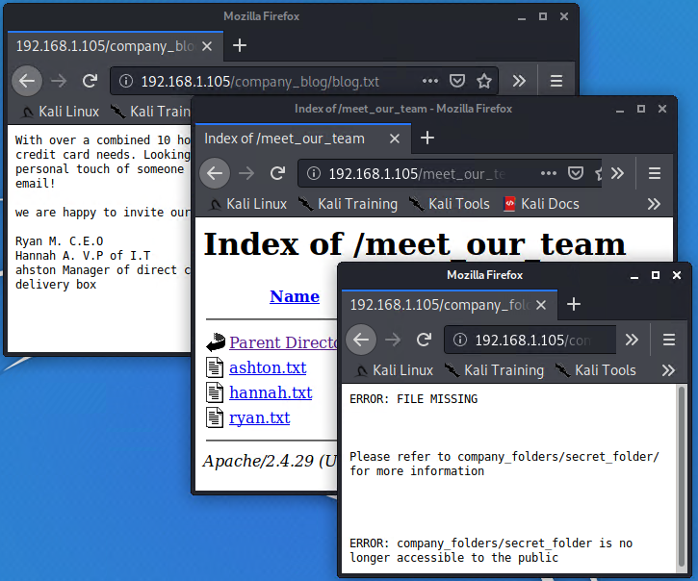
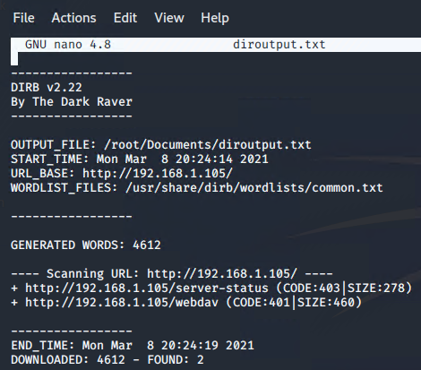
Exploitation: [Directory Listing Vulnerability/CWE-548]
01
02
03
Tools
Firefox Web Browser
The Dark Raver -DirB
Processes
Navigating/traversing the website and accessing the information.
The DirB Is another method is similar dictionary attack
Achievements
Navigating the website yeilds informaton that can be used to determine that there is a secret directory.
For example, the meet_our_team directory reveals .txt file that provide the partial location of the /secret_folder
Using DirB an outfile can be created revealing locations that were found as well.

Slide 10
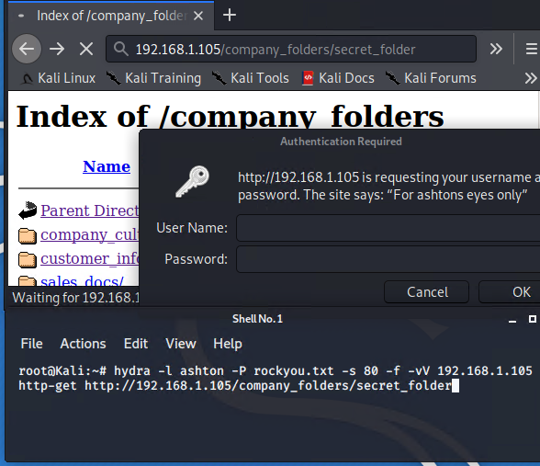
Exploitation: [CWE-521: Weak Password Requirements]
01
02
03
Tools
Rockyou.txt word listTHC
Hydra
Firefox Web Browser
Username Credentials
Processes
Username as well as the login location is found while traversing the directory through the web browser of choice.
Applying the Password Cracking Tool Hydra with a world list yields a password.
Achievements
Password for Ashton was in ‘Rockyou’ dictionary.
Access to the /secret_folder/ was achieved
Information regarding /webdav/ access found
Easily covertible Hash for another users password found

Slide 11
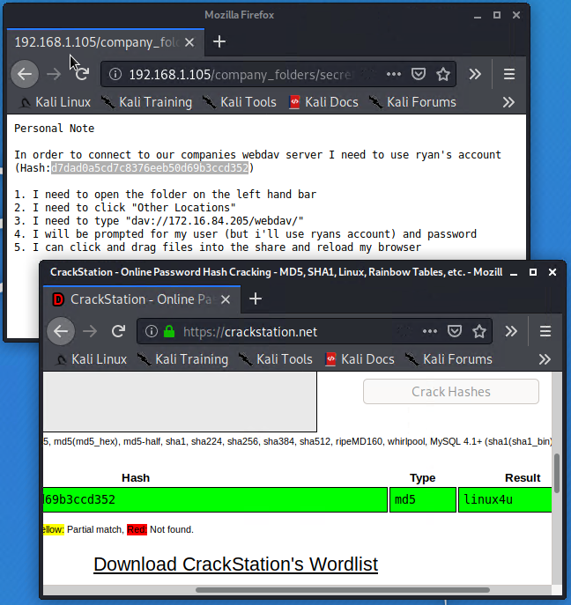
Exploitation: [Weak Password Requirements]
01
02
03
Tools
THC Hydra
Crackstation.net
The password Hash from /secret_folder/
Processes
THC Hydra supplied password for access to /secret_folder.
Supplied the hash found inside the directory to Crackstation.net for conversion.
Achievements
THC Hydra supplied password for access to /secret_folder.
The hash found inside the directory
Crackstation.net converted hash into a password for another user(Ryan)

Slide 12
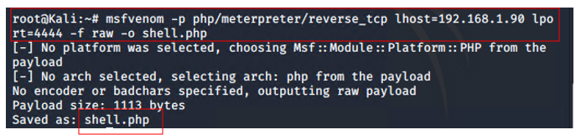
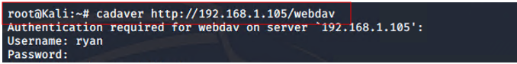
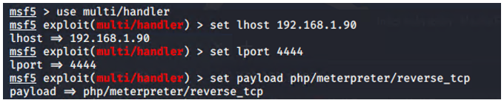
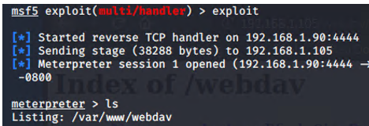
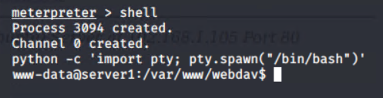
Exploitation: [CWE-434: Unrestricted Upload of File Type]
01
02
03
Tools
Metasploit tool
msfvenom
Processes
Created and uploaded a playload for the msfvenom
Set up a listener for when .php file was executed
Executed the reverse shell backdoor on the Capstone Apache Server.
Achievements
Created a remote backdoor shell to the Capstone Apache Server
Gained access to root directory

Slide 13

Blue Team
Log Analysis and Attack Characterization
‹#›

Slide 14
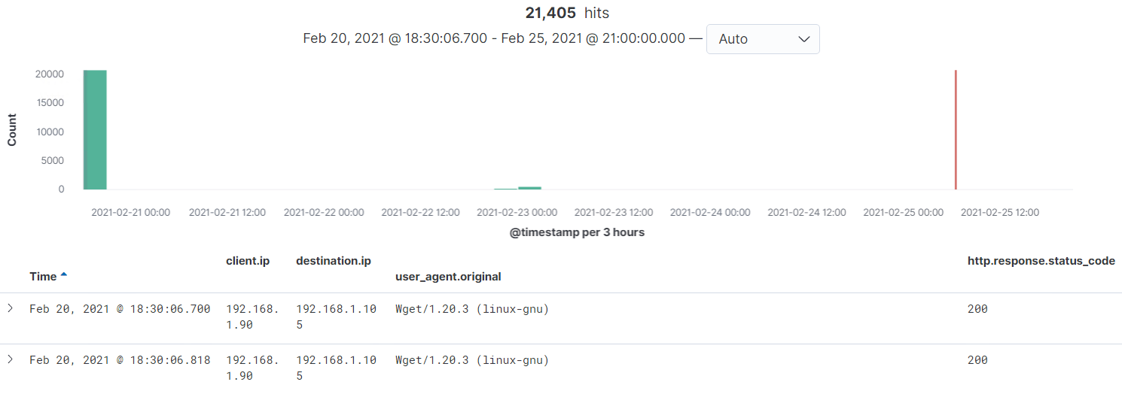
Analysis: Identifying the Port Scan
What time did the port scan occur?
2021-02-20 @18:30:06.700
How many packets were sent, and from which IP?
72 packets were sent from 192.168.1.1
20,795 were from 192.168.1.90
What indicates that this was a port scan?
The number of requests submitted in a short amount of time.

Slide 15
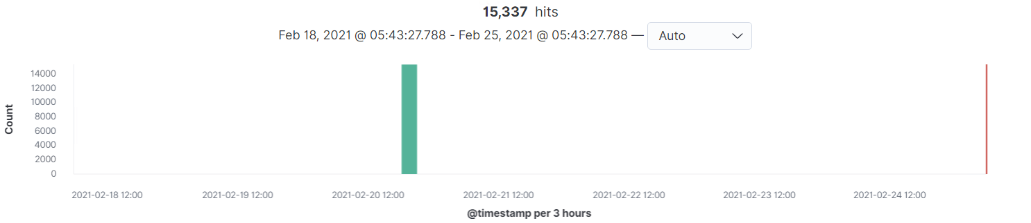
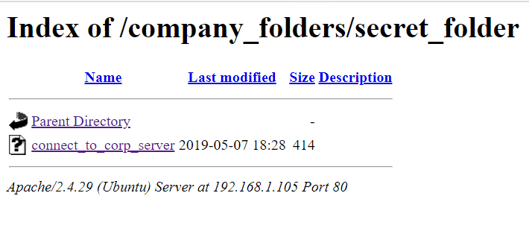
Analysis: Finding the Request for the Hidden Directory
The image above identifies the number of requests made to the hidden directory /secret_folder. Below you find the visual representation when accessed through a browser.
15,337 requests were made of the directory /secret_folder.
These requests began on 2021-02-20@18:46:07:411
The requests were made from the IP 192.168.1.1 and 192.168.1.90
The files requested was connect_to_corp_server file
This file contained a hash that could be used to access the companies webdav server using another employee’s credentials (Ryan). The file also contained instructions on how to access the webdav server.

Slide 16
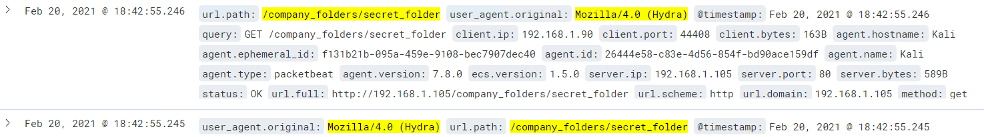
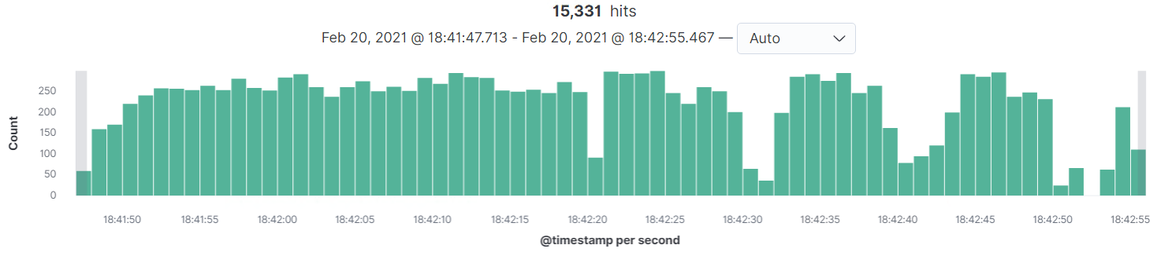
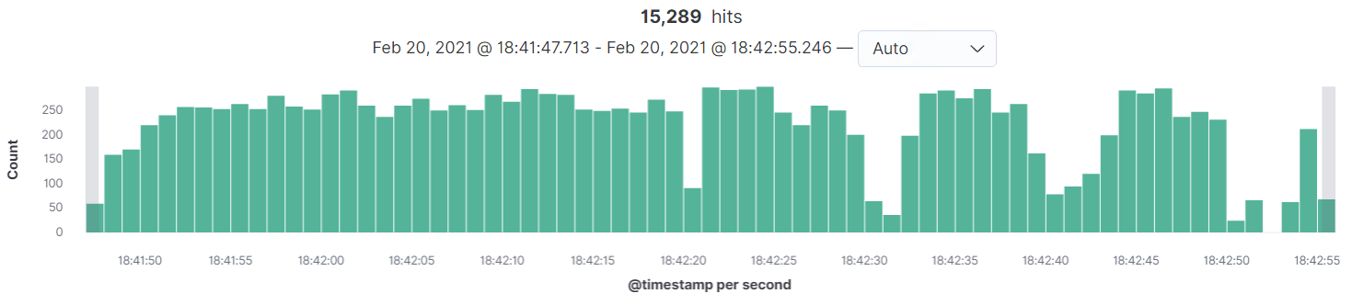
Analysis: Uncovering the Brute Force Attack
In order to access the /secret_folder the brute force tool named Hydra was used. The image on the left Identifies those packets in the hydra attack.
15,331
Requests were made in the attack
Requests had been made before the attacker discovered the password.
15,289

Slide 17
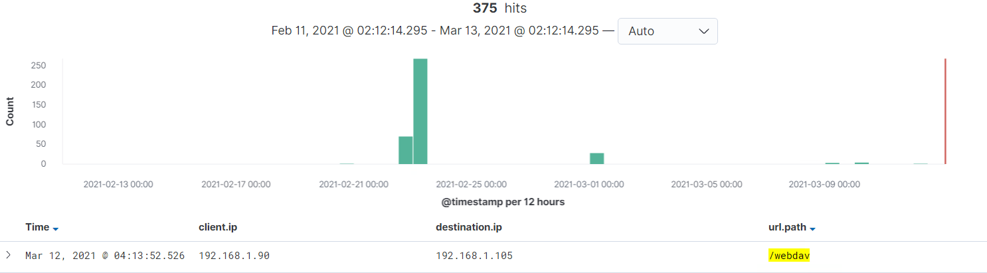

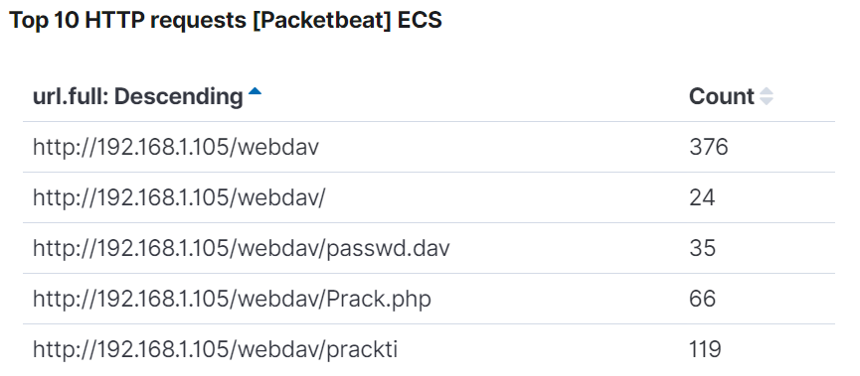
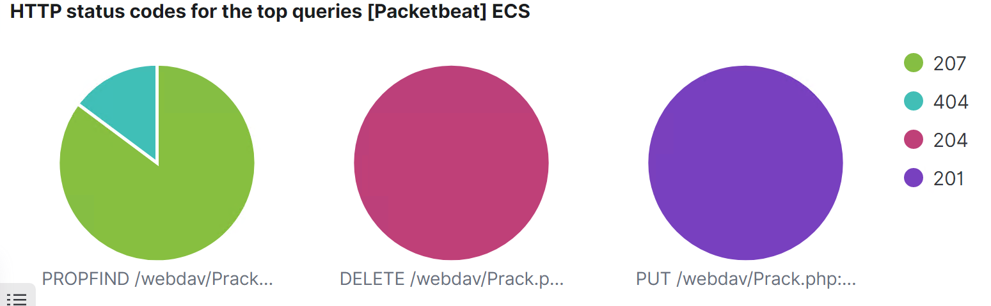
Analysis: Finding the WebDAV Connection
Hits for /Webdav 400
Using the Kali –attackers machine IP as the source.ip and the Capstone machine as the destination IP, we were able to identify the number of requests made to the folder and specific files.
35 requests were made for file named passwd.dav which contained credential information for Ryan. However, equally important was the 66 requests indicated below for the reverse shell php file.
Hits for Prack.php (reverse shell) 66

Slide 18
Blue Team
Proposed Alarms and Mitigation Strategies
‹#›

Slide 19

Mitigation: Blocking the Port Scan
Considering that the information is logged and sent to Kibana. Researching the Elastico.co/blog website provided information on regarding implementation of host port scanning.
The article stated that using a watcher an email alert can be generated. For example, if within 30 seconds a host has established more than 50 connections each using a different port against another host.
Juniper Networks indicates that the default threshold to be deemed a port scan attack is 10 ports in 0.005 seconds
An email alert could be triggered by setting up a watcher that interprets attempted connections to the host by using different ports
To mitigate port scans
Ensure that there is a firewall application. The Capstone machine had firewall application UFW.
Ensure that the application is running. The UFW application was inactive which enable the red team to port scan and see what was accessible. When enabled the ufw default sets incoming traffic to be denied.
Set up custom IP tables which can be done in the before.rules and after.rules in the /etc/ufw/ folder.
Command for UFW: sudo ufw enable sudo ufw status verbose
Sudo ufw allow from Specific_static_IP to any port ##

Slide 20

Mitigation: Finding the Request for the Hidden Directory
An email alert can be generated when there is unauthorized access from a user on the system.
The suitable threshold for this email to be generated would be 1 unauthorized access determined by the system.
The rules by which the system would determine whether this is in fact unauthorized is based on a comparison to the list of allowed users from allowed IP addresses.
To resolve this issue the httpd.conf file needs to be edited. The httpd.conf file is main configuration file for the Apache Web server. Within the file is a section for the specific directory on the website.
Apache directory listing is provided by an AutoIndex module. If enabled the module shows the list of files and folders if no DirectoryIndex files are present. Disable directory listing in apache by removing Indexes:
Command :
<Directory /var/www/company_folders/secret_folder/>
Order allow,deny
Allow from 192.168.1.1
Allow from 192.168.1.105
Allow from 127
Deny from 192.168.1.90
</Directory>
Options Includes FollowSymLinks MultiViews

Slide 21
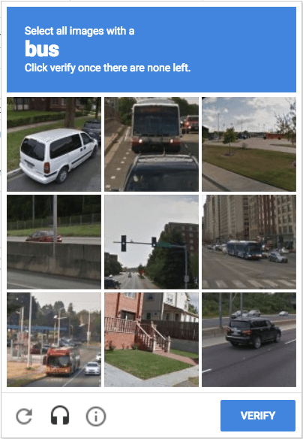
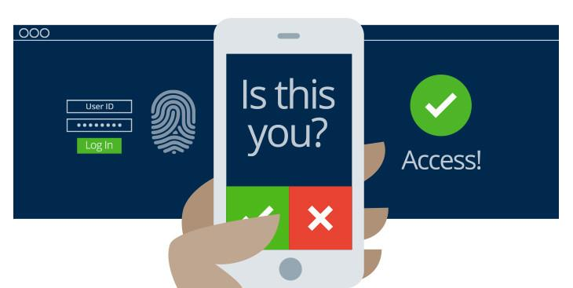

Mitigation: Preventing Brute Force Attacks
An email alert that would be a suitable alarm for a brute force attack. The alert could be triggered based on a signature that is indicative of the attack. For example, Cisco – 2002/0 signature detects 60 “HTTP 401” messages in 60 seconds.
Based on that Cisco signature it can be recommended that the threshold for the Capstone machine be set as; trigger an email alert if more than 10 Error 401(unauthorized) are received in 10 seconds.
For more protected information trigger an email alert if more than 5 Error 401 occur at any time or OK 200 is a response from untrusted IP.
Implement a strong password policy. For example, passwords must be 8 – 16 character, have at least 1 upper & lower, number, and special character.
Implement multi factor authentication. Upon login there is another login that requires other information. For example, answers to security questions, pin. Implement a captcha to test whether it is a person of computer login in. .

Slide 22
Mitigation: Detecting the WebDAV Connection
An email alert can be generated when there is unauthorized access from a user on the system.
The suitable threshold for this email to be generated would be 1 unauthorized access determined by the system.
The system would determine whether this is in fact unauthorized based on a comparison to the list of allowed users from allowed IP addresses.
To resolve this issue the httpd.conf file needs to be edited at the section for the specific directory on the website.
Modifying the configuration on the host. The purpose of the modification is to block access from unauthorized users to the “webdav”. Thereby blocking access from any IP other than those listed.
Command :
<Directory /var/www/webdav/>
Order allow,deny
Allow from 192.168.1.1
Allow from 192.168.1.105
Allow from 127
Deny from all </Directory>

Slide 23
Mitigation: Identifying Reverse Shell Uploads
An email alert can be generated when there is unauthorized access from a user on the system and as well when there is unauthorized file upload taking place.
The suitable threshold for this email to be generated would be based on the “put” method request from non-trusted IPs.
The rules by which the system would determine whether this is in fact unauthorized file upload is based on comparison to the list of allowed users IP addresses allowed to access and upload.
To resolve this issue the httpd.conf file needs to be edited at the section for the specific directory on the website.
The HTTP protocol supports many request methods which can be tailored to suit the organizations needs
By default, the methods available for use are Options, Get, Head, Post, Put Delete, Trace and Connect are set. Denying them all would disable non-trusted Ips from uploading files.
Command :
<Directory /var/www/webdav/>
Order allow,deny
Allow from 192.168.1.1
Allow from 192.168.1.105
Allow from 127
Deny from all <LimitExcept GET POST HEAD> Deny from all </LimitExcept>
</Directory>

